Slide 1
Chapter 11:
Enable and Practice Continuous Integration
Presented by Amy Zuniga & Kendall Noble

Slide 2
Introduction
Continuous Integration
Small Batch Development and what Happens When We Commit Code to Trunk Infrequently
Adopt Trunk-Based Development Practices
Continuous Integration at Bazaarvoice (2012)
Conclusion

Slide 3

Gary Gruver’s Experience - HP’s LaserJet Firmware
What was wrong:
Very slow at delivering new features
Only two firmware releases per year
Only 5% of time was spent creating new features, other 95% was non-productive work
What they did to improve:
Continuous integration and trunk-based development
Invested in test automation
All developers work in common code base
Invested in printer simulators
Created a swarming culture
Notes:
Gruver was the director of engineering for HP’s Laserjet firmware division which builds the firmware that runs all their scanners, printers, and devices
400 developers, moved very slowly. Non-productive work included detailed planning, porting code on separate code branches, integrating and manually testing

Slide 4
Gary Gruver’s Experience - Results
Went from 20 commits a day to over 100 commits per day
Reduced test times from 6 weeks to one day
Time spent innovating and creating new features went from 5% to 40%
Development costs were reduced by 40%
Development costs were decreased by 78%
Gruver’s experience shows that continuous integration is one of the most critical practices in a value stream

Slide 5
Small Batch Development and What Happens When We Commit Code to Trunk Infrequently
Two main branching strategies:
Optimize for individual productivity
Optimize for team productivity
Troubles with large batch size merges:
The required effort to merge branches together increases exponentially as the number of branches increase
Less able and motivated to improve and refactor code when merging is difficult
Technical debt
Continuous integration and trunk-based development can help solve these problems
Notes:
Optimize for individual productivity: Every person on the project works in their own private branch, but merging becomes a nightmare, collaboration is very difficult
Optimize for team productivity: Everyone works in the same common area, no branches, just a long straight line of development, simple, each commit can break the entire project
Technical debt: when we don’t commit code frequently, it becomes more difficult to maintain and make changes overtime. Just like money debt

Slide 6
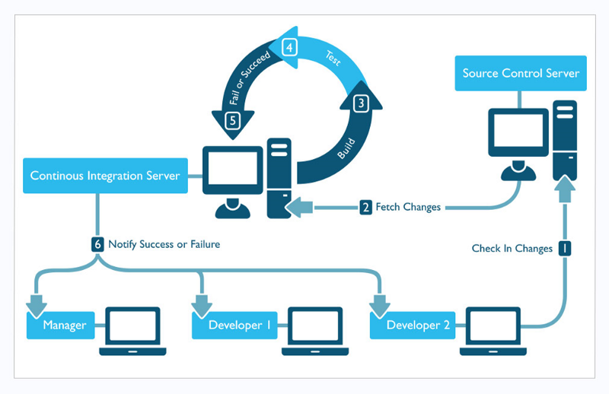
Adopt Trunk-Based Development Practices
Continuous Integration is a countermeasure to large batch size merges
Checking Code frequently reduces batch sizes to the work performed by our entire developer team in a single day
The more frequently developers check in their code to the trunk, the smaller the batch size and the closer we are to the theoretical idea of single-piece workflow

Slide 7
Adopt Trunk-Based Development Practices
Frequent Code Commits Mean:
We can run all automated tests on our software system as a whole
Receive alerts when a change breaks other parts of the application or interferes with the work of another developer
Faster detection/correct of small merge problems
Gated Commits: Prevents negative impacts in value stream
Notes:
After 3rd bullet point
We may configure deployment pipeline to reject any commits that take us our of a deployable state also called Gated Commits where the deployment piplelinbe first confirms the submmited change will successfully merge, build as expected, and pass all automated tests before actually being merged into trunk. If it fails, the developer is alerted allowing corrections to be made without impacting anyone else in the value stream

Slide 8

Adopt Trunk-Based Development Practices
Benefits of Frequent Code Commits:
Breaks work down into smaller chunks
Version Control becomes an integral mechanism of how the team communicates with each other
Allows us to redefine definition of “Done”
Notes:
After 1st bullet point: While still keeping trunk in a working, releaseable state
Defintion of done to include
“At the end of each development interval we must have integrated, tested, working, and potientially shipppable code demonstrated in production-like enviornment, created from trunk using a one click process, and validated with automated tests.

Slide 9
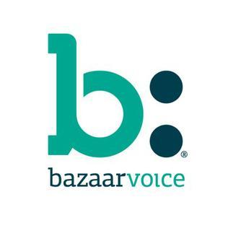
Continuous Integration at Bazaarvoice (2012)
Adopt Trunk-Based Development Practices
Notes:
Bazzaar voice supplises customer generated content reviews, ratings for thousands of retailers inc best buy, nike, and wlamart
Had 120 milliion in revenue and was preparing for IPO,. Primarily driven by a monolithic java applcication comprised of five mllion lines of code ,the service ran on 1200 serers across 4 data centers and multiple cloud service providers

Slide 10
Bazaarvoice Overview & 3 Core Problems
Initially had 10 week production release schedule
Start by decoupling monolithic application, and breaking it down to microservices
After 1st disastrous two week release schedule Mueller took over the release process
Lack of Test Automation
The Version Control Branch allowed developers to check in new code right up to production release date
Teams running microservices were also performing independent releases
Notes:
After Bazzarr voice switched to Agile development process and two week development intervals, indicated they needed to change
Say first bullet
After third bullet
with the goal of doing bi-weekly releases without causing customer downtime
Muller than identified 3 problems

Slide 11

Bazaarvoice: Changes
In six weeks the following changes ensued:
Developers stopped doing feature work to focus on writing automated testing suites (unit testing, regression tests)
Getting a deployment pipeline running
Encorporated trunk/branch release Model
Notes:
Where every 2 weeks they created a new dedicated release branch
No new commits allowed unless there was an emergency
All changes work in sign off process
Branch wotuld go through a QA process
Afterwards the company hgad improvements to predictability and quality of the releases
Went to weekly releases
Abitly to work and achiebe other goals
Red
Bazaar Benefits of Adopting Trunk
Speeding up test times
Reducing number of environments from 4 to three
Moving to full continuous delivery model where we enabled fast one click deployments

Slide 12
Conclusion
Trunk based Developments is the most controversial practice
Puppet’s Lab 2015 State of DevOps is clear
“Trunk based development predict higher throughput and better stability, and even higher job satisfaction, and lower rates of burnout.”
Continuous Integration is the foundation for automating the deployment process and enabling low-risk releases

